Slide 1
What is the potential of social prescribing in tackling loneliness? Panel Session: The role of health & social care in tackling loneliness
Suzanne Moffatt Professor of Social Gerontology Population Health Sciences Institute Campaign to End Loneliness International Conference
18th November 2021 suzanne.moffatt@ncl.ac.uk

Slide 2
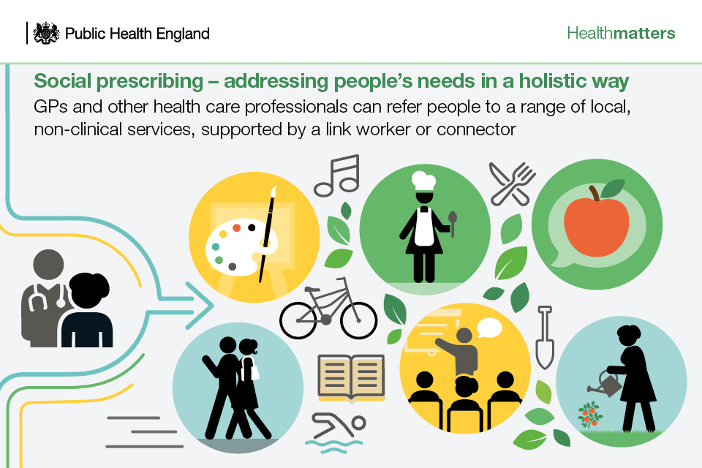
What is social prescribing?
SP enables healthcare professionals to address non-medical causes of ill-health through using resources of the voluntary & community sectors
To encourage engagement many SP schemes involve a facilitator (link worker) who supports service users to identify and achieve personalised goals
No single model, but now part of NHS primary care

Slide 3
Evidence on SP addressing loneliness and social isolation
Foster et al 2020 Evaluated national social prescribing programme funded by British Red Cross
Delivered by paid link workers & volunteers, 12 week programme
Target population adults aged 18 + years (mean age 66 years, range 18+-75+)
Results: immediately post-intervention over 70% reported reduced loneliness- UCLA-3 (n=1634/2250)
Three month UCLA follow up of n=101, 60% experienced worsening of loneliness
Possible explanations: (i) ending of link worker/volunteer support with transport;
(ii) service users missing relationships developed with ink worker/volunteer
Raises questions about length of SP interventions and what can reasonably be expected from a 12 week programme
Foster et al Impact of social prescribing to address loneliness: A mixed methods evaluation of a national social prescribing programme Health & Soc Care in Comm 2020

Slide 4
Social Prescribing in the North East (SPRING_NE Study)
Aims
To evaluate the impact and costs of a link worker social prescribing intervention on health and healthcare costs and utilisation and to observe link worker delivery and patient engagement.
NIHR Public Health Research Programme Project 16/122/33

Slide 5
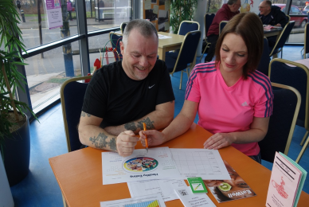
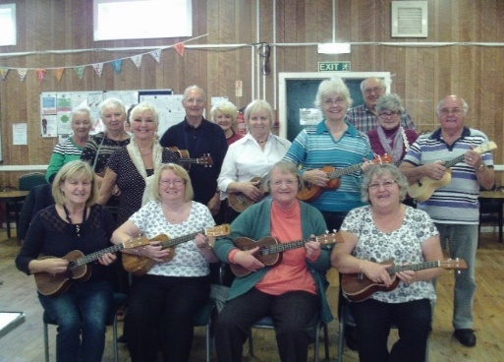
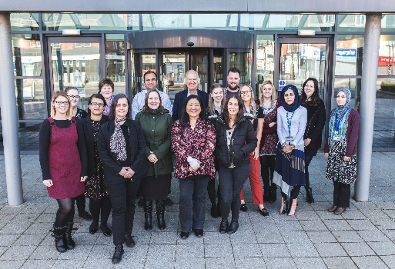
Ways to Wellness social prescribing
Link workers
26 FTE across 2
Providers
(NHS Band 2-3-4)
26 FTE Link workers
across 2 providers
(NHS Band 2-3-4)
https://waystowellness.org.uk

Slide 6
Varied client experiences of social prescribing engagement/delivery
A VARIATION IN ‘DOSE’/INTENSITY
Some participants experienced an holistic intervention which was deeply connected with their lives and a key form of support
Other participants’ experienced a light-touch intervention more akin to signposting

Slide 7
Meet ‘Tracy’ …
… Before the heart attack, I used to drive, and I used to pop out everywhere … but now I’ve got to a stage where I’ve been unwell, I sit in a lot just waiting for that next appointment to come through … [link worker] gave me a form, a newspaper, so we can do free courses. So I’m looking into a cookery course … I need to try and get better, get my health better, because it’s depressing having to sit and do nothing all day.
Open and trusting relationship with link worker key to positive experience
of social prescribing (Moffatt et al 2017, BMJ Open 2017;7:e015203)

Slide 8
Value of groups
Before [the group], I didn’t have a life … I just felt like a recluse … I enjoy actually meeting, actually going, seeing the same faces. It’s nice to meet new people, it’s nice to meet people that have got the same problems.
The conversation moves to [name] pool opening and the link worker says ‘I thought of you [Tracy] because I know you like swimming’ … ‘What would you need to help you to go?’ the link worker asks. I don’t know, Tracy says, not right now. The only other female attendee [Janice] says she’d go with Tracy and the link worker suggests they call in for a coffee and see what it’s like before they go. Paul interrupts with another story and while he’s talking Janice quietly asks Tracy what size swimming costume she takes and offers to see if she has anything at home she can dig out for her.
Field notes
Attendees fostered (bio)socialities around shared experiences: personal issues were addressed collectively rather than individually (Guell 2011, Med Anthropol Q 25(3): 377394)

Slide 9
Conclusions
Link worker-client relationship very important
Facilitating peer support via group work highly valued
Variation in social prescribing offer from highly embedded through to signposting
Time span of social prescribing needs careful consideration – what happens when social prescribing ends?

Slide 10
Risks
Social prescribing expected to provide low-cost solution to many complex problems
Austerity-driven public sector cuts impact on onward referral opportunities
Long-term impact of COVID-19 on clients and services

Slide 11
Acknowledgements
SPRING_NE Study Team
Study participants
Ways to Wellness, provider organisations and link workers
Newcastle Gateshead Clinical Commissioning Group
National Institute of Health Research

Slide 12
Further Information
Gibson K, Pollard TM, Moffatt S (2021) Social prescribing and classed Inequality: a journey of upward health mobility? Social Science & Medicine 280, 114037
Wildman J, Wildman JM (2021) Evaluation of a Community Health Worker Social Prescribing Programme Among UK Patients with Type 2 Diabetes. JAMA NETW Open; 4 (9):e 212636
Study website: https://research.ncl.ac.uk/nuspe
End of Award conference http://www.fuse.ac.uk/events/researchprogrammemeetings/previousmeetings/impactofsocialprescribingonhealthwellbeing.html and YouTube channel: https://youtu.be/GudhRCM4UDs
End of award report published by NIHR in 2022

